Slide 1
COP4020 – Programming Languages
Implementing
Subprograms

Slide 2
Calling a Subroutine
Calling a Subroutine involves these steps:
  1) Save caller's state (IP and register values)
  2) Create activation record for callee
    Allocate correct amount of space for Activation record
    Pass appropriate parameter values (value, reference, etc)
    Set static and dynamic links and return address
  3) Enter callee in context of new activation record
Returning from subroutine involves
  Copy out any value-result or out-mode parameters
  If the subprogram is a function, functional value is moved to the caller
  3) Delete callee's activation record (pop stack)
  4) Restore state of caller
  5) Transfer control to the caller

Slide 3
Nested Subprograms
Block Structured Languages - Support multiple instances of a procedure or function - recursion.
  Fortran 95
  Ada
  JavaScript
Static Chain - chain back through the static nested scopes of methods (seen in contour diagrams)
Dynamic Chain - the sequence of activation records placed on the application stack
Static nesting level (snl) - knowing the nesting depth of a method. May be determined at compile time
Static distance (sd) - difference between two constructs’ static nesting levels
Static Scoping - in environment of definition - based on static chain
Dynamic Scoping - in environment of caller - based on dynamic chain
To access variables under static scoping:
  1) Follow static chain to activation record of declaration
  2) Move offset of variable within the record

Slide 4
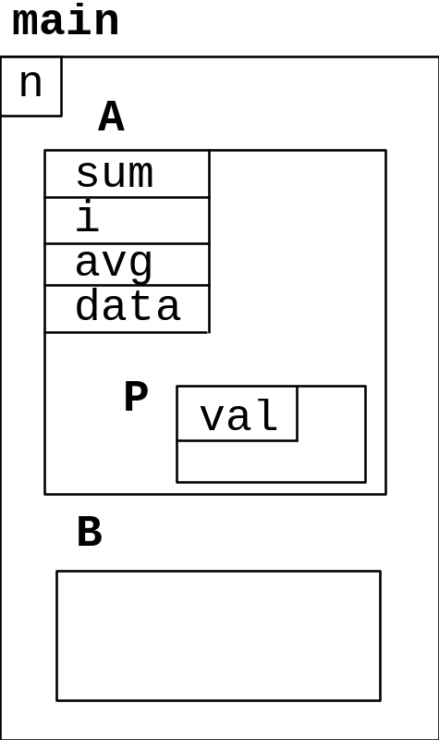
Example
program main;
var n:integer;
procedure A(sum:real);
var i:integer;
avg:real;
Data:array [1..10] of real;
procedure P (val:real);
begin
. . .
writeln(data[i]);
end;
begin
. . .
end; {A}
procedure B;
begin
. . .
end; {B}
begin
. . .
end. {main}

Slide 5
Example
The Symbol Table:
name type snl offset
N integer 1 1
sum real 2 1
i integer 2 2
avg real 2 3
Data real array 2 4
val real 3 1

Slide 6
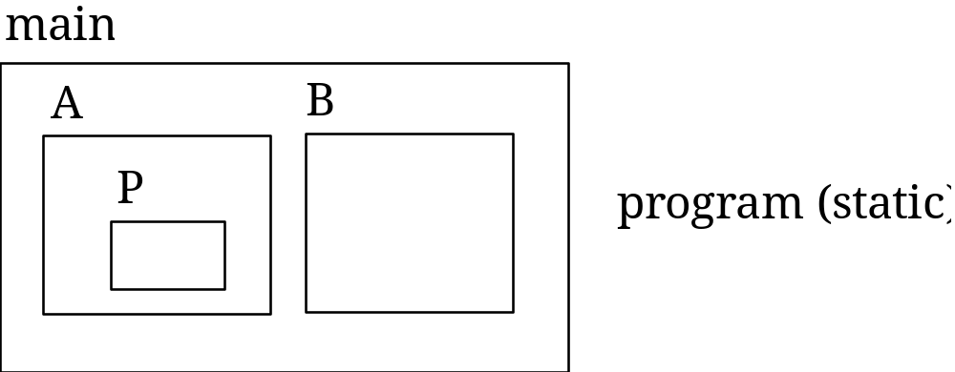
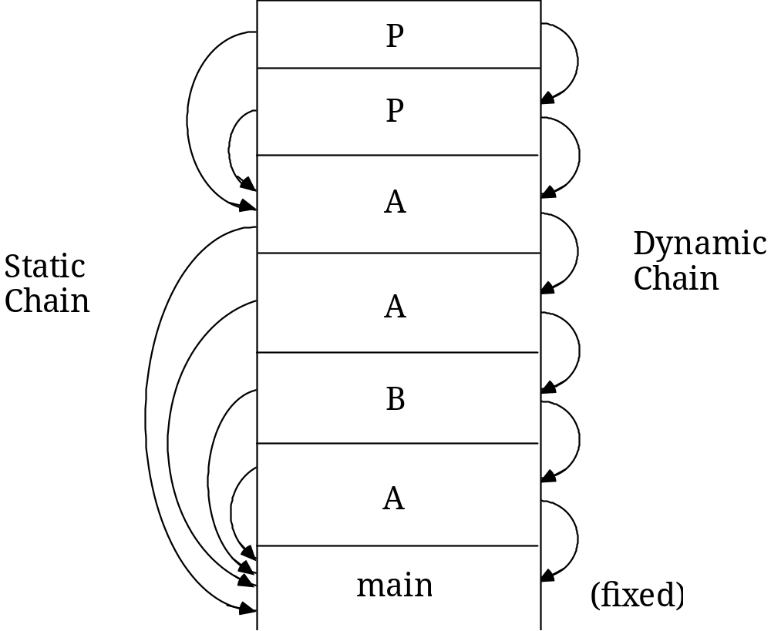
Static and Dynamic Chains
Static Chain in a statically scoped language
Stack of
Activations:

Slide 7
Resolving Variable References
Resolving Variable References can be done in two different ways:
  Static Chain - follow static chain until name is found. Requires (sd +1) accesses (static depth + offset)
  Display - Since static nesting level (snl) is known at compile time, an array D, called a display may be kept: D[i] points to the current activation record at static nesting level i. A variable X at snl is obtained directly at D[snl] + offset

Slide 8
Scope Rules
Fortran had two levels of scope
  Subprograms in outer scope (global)
  Variables in inner (local) scope
Blocks Define Nested Scopes in many languages:
  Variables are bound upon entering the block in which they are declared. They are visible only within that block and within any nested blocks.
  Other program units cannot see into local contexts
  The name of a method is visible in the block in which it is defined (otherwise it couldn’t be called)
  If two or more declarations of the same variable name occur within nested scopes, only the innermost is visible within its scope. The innermost declaration prevents access to the outermost declaration.

